Slide 1
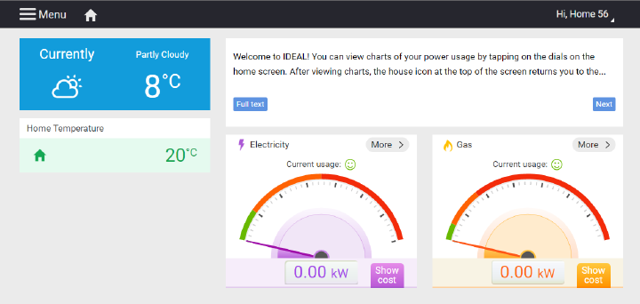
Data Science for Design IDEAL-How are people using our feedback?
Jerry Lin
YI Shen
Hsin Chieh Tsai

Slide 2
Outline
Introduction
Data Provided by Data Owner
Audience – Data Owner (App Developer)
Demonstration of Analysis

Slide 3
Introduction
Our data is about the usage and app information of an app, IDEAL
The app is used to collect feedback of energy use in people’s households.
The analysis of data could help developers of IDEAL to improve the app.

Slide 4
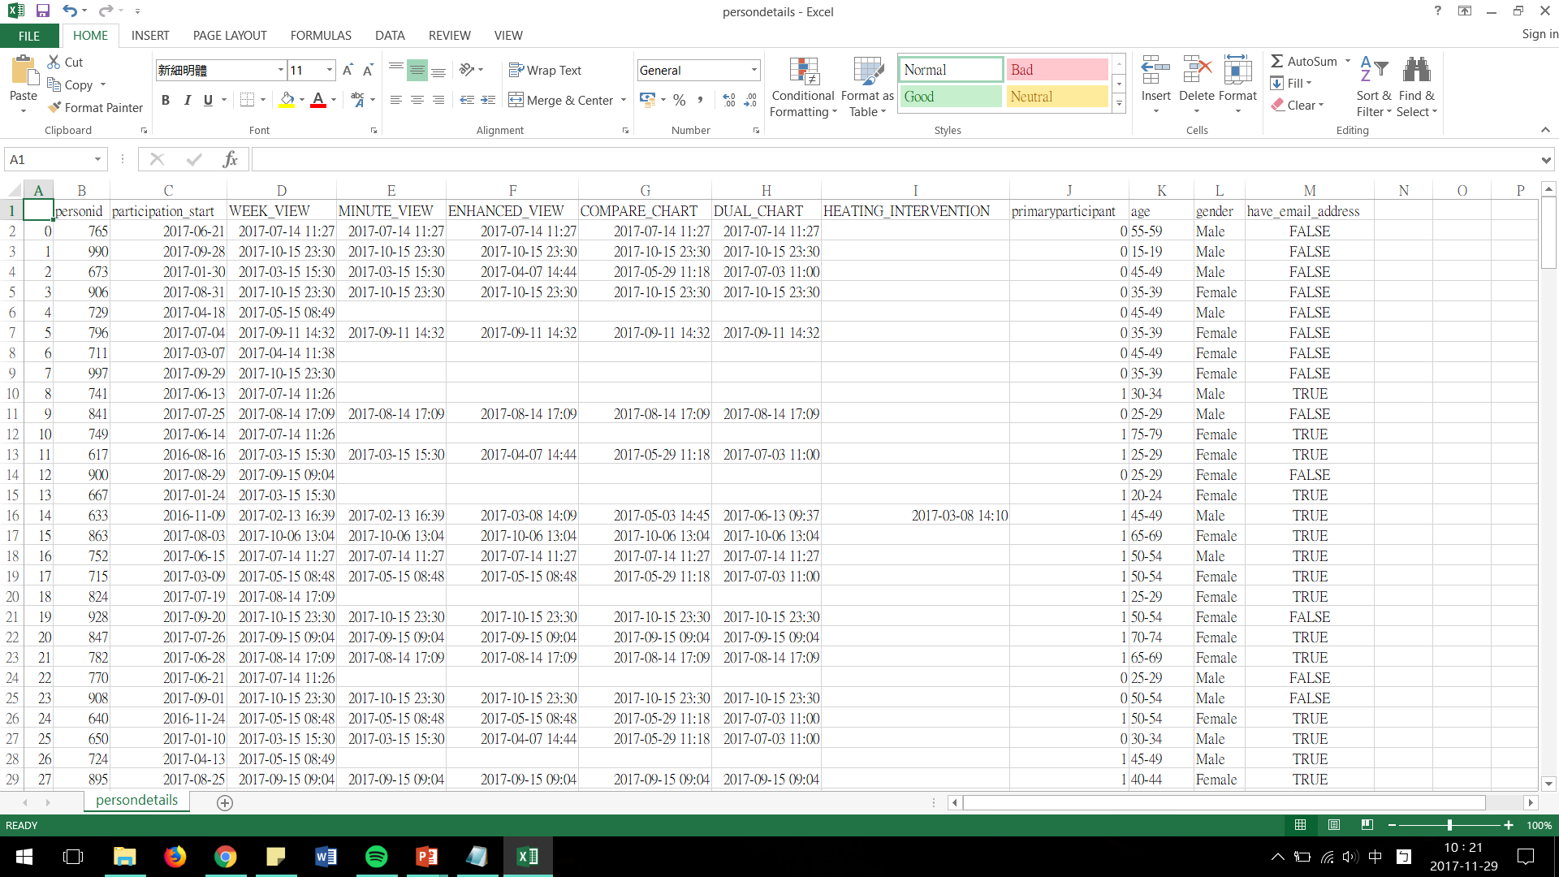
Data Provided by Data Owner

Slide 5
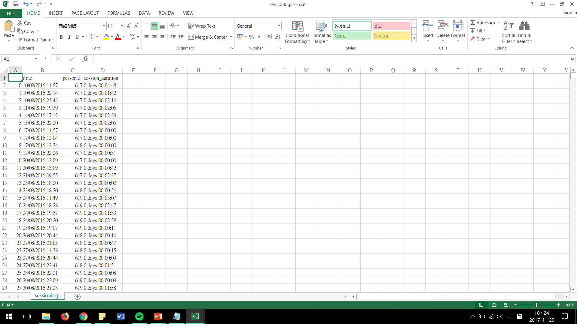
Data Provided by Data Owner

Slide 6
Audience – Data Owner (App Developer)
What we are trying to convey
Part1: Who is the main participants
to help them know better about their users
Part2: The details of login
to help them understand the times and the duration that user will use the App
Part3: New features
to help them understand the relationship between new feature release time and user log in time and select the best time to release new features

Slide 7
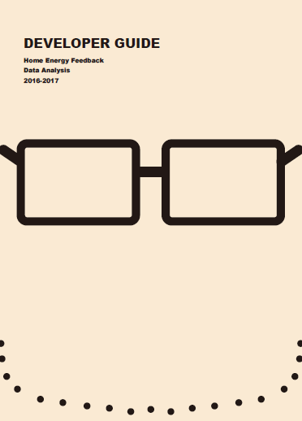
Demonstration
Developer Guide
Our main Findings

Slide 8

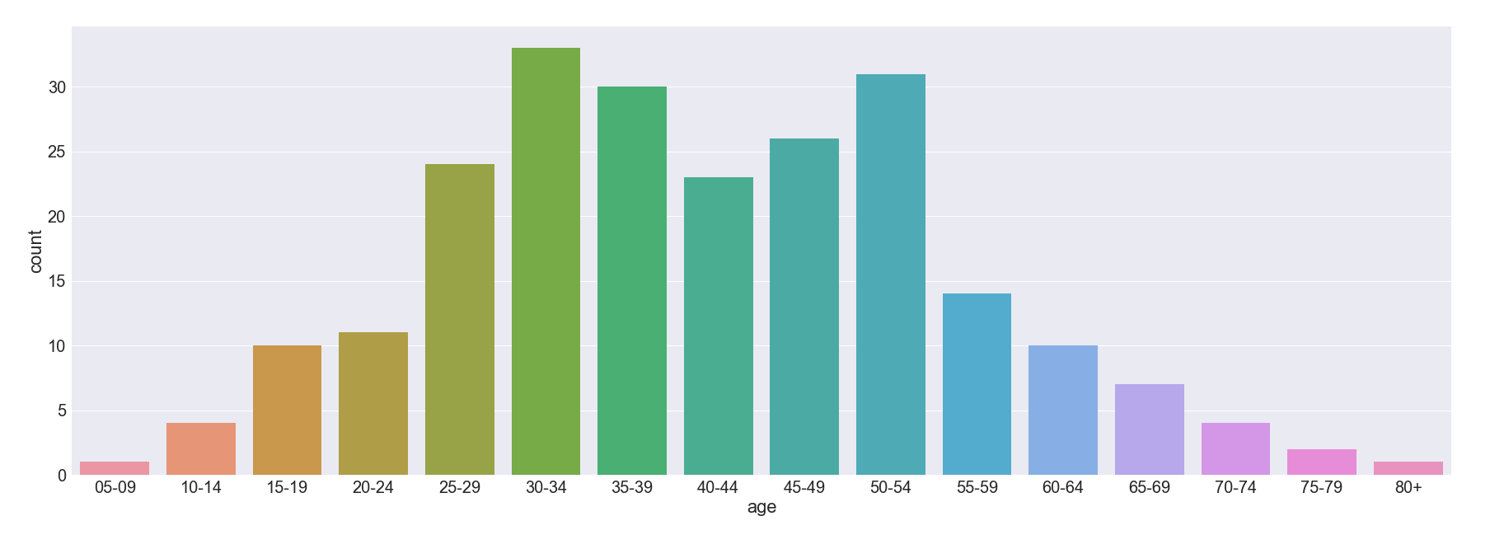
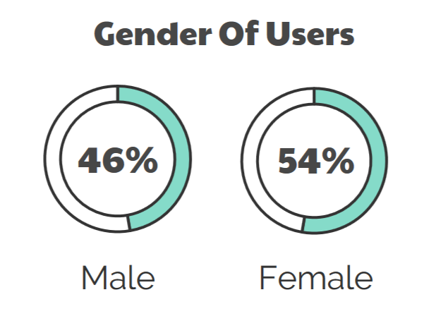
Demonstration
Part1: Who is the main participants
There are more female participants than male.
Participants aged 30-34 occupies the largest number of all participants

Slide 9
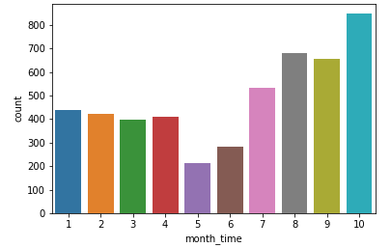
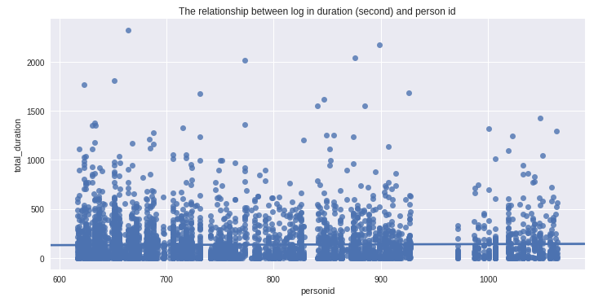
Demonstration
Part2: The details of login
Most participant log in duration is below 500 second (8 minute 20 second) and there are only very few people logged in over 2000 second (33 minute 20 second).
The user largest logged in times 265, the average log in time is around 24, and the smallest log in time is 1.
Participants tend to login to system after summer.

Slide 10
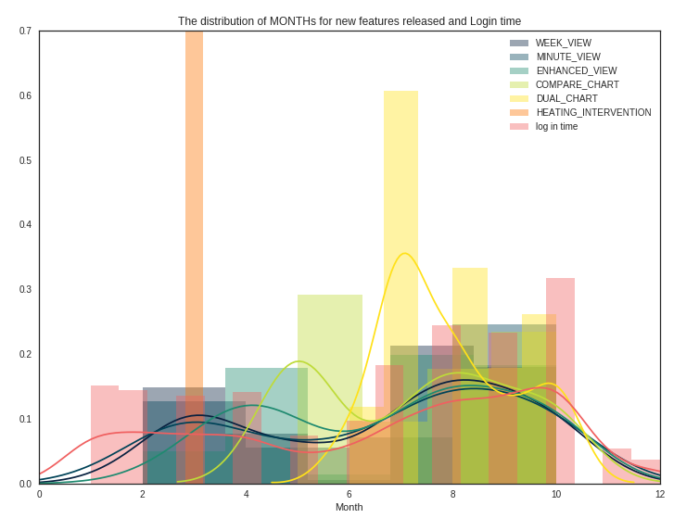
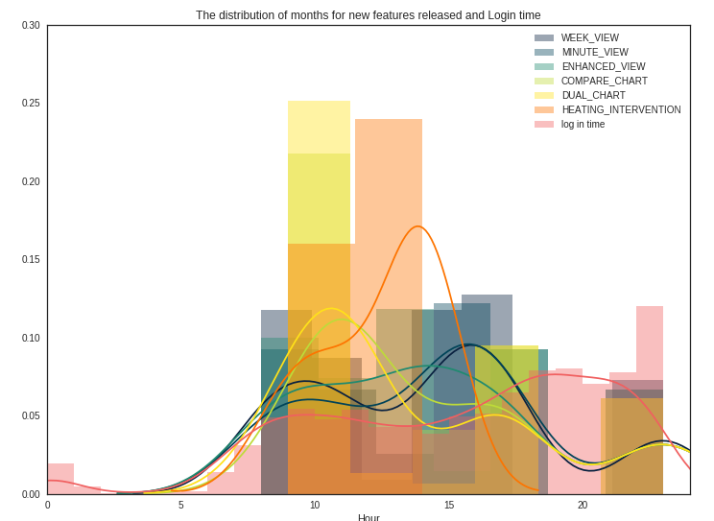
Demonstration
Part3: New features
The released month of new feature is good but released hour in the afternoon need to adjusted to a later time.

